Slide 1



Next Gen Resume : Future of Recruiting
Welcome to the Next Gen Resume presentation, where we'll explore the future of recruiting and how our platform empowers job seekers.
by Vyom Kalariya

Slide 2
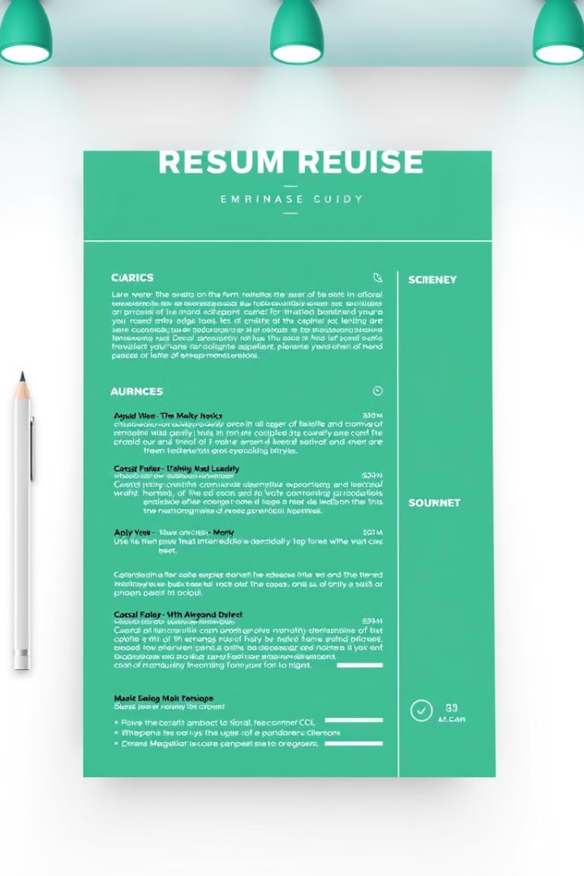
Next Gen Resume - Visually Stunning & easier to download files and reach to the employee
Visually stunning, dynamic layouts capture recruiter attention.
Easier to download files and reach to the employee and there social network.
Everything is available in one place

Slide 3
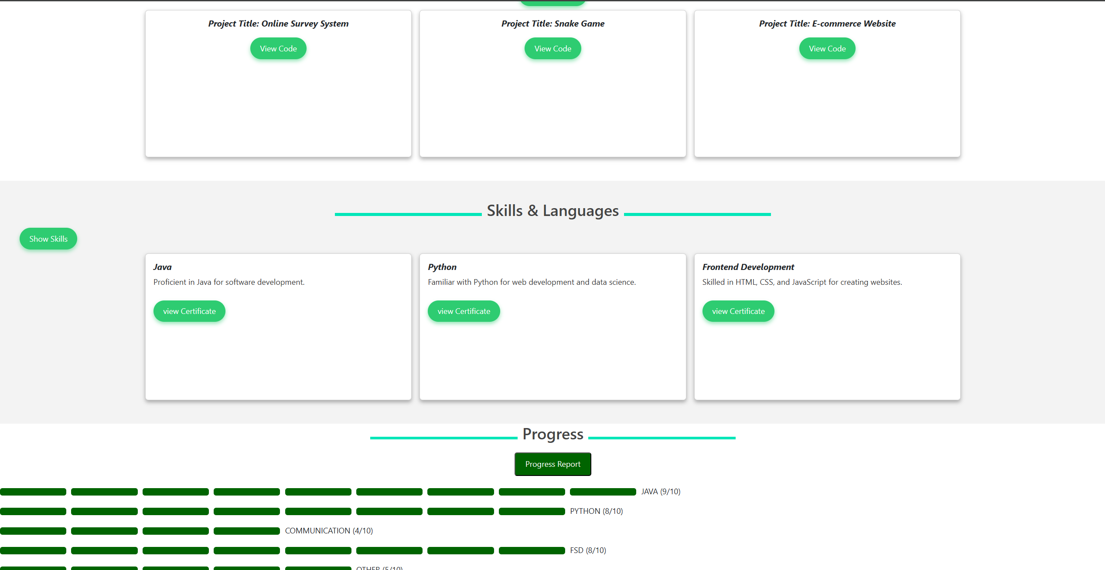
Strong Points of my Website
Get Project Through Git-hub
Can View certificate and get Detailed information from Coarsera
Everything is available
in one place

Slide 4
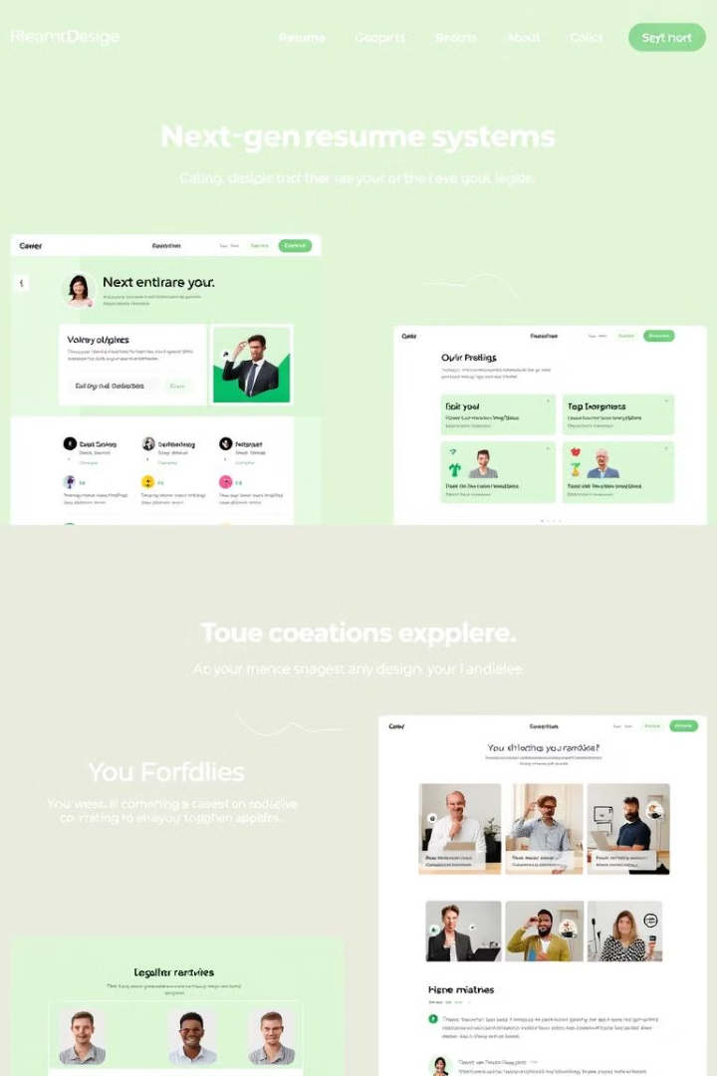



Key Features: Dynamic Layouts, Skill Endorsements, Integrated Portfolio, Get every Document in one place
visually appealing layouts to showcase your skills and experiences.
Gain credibility through endorsements from peers, validating your professional skills.
Effortlessly integrate your professional portfolio with your resume for a comprehensive showcase.

Slide 5

Preview : The stunning Animations and Designs
1
Intro page and login page to secure Documents
2
Add your work experience, skills, and education.
3
Recruiter can get everything in one place
4
Download your resume and share it with potential employers.

Slide 6
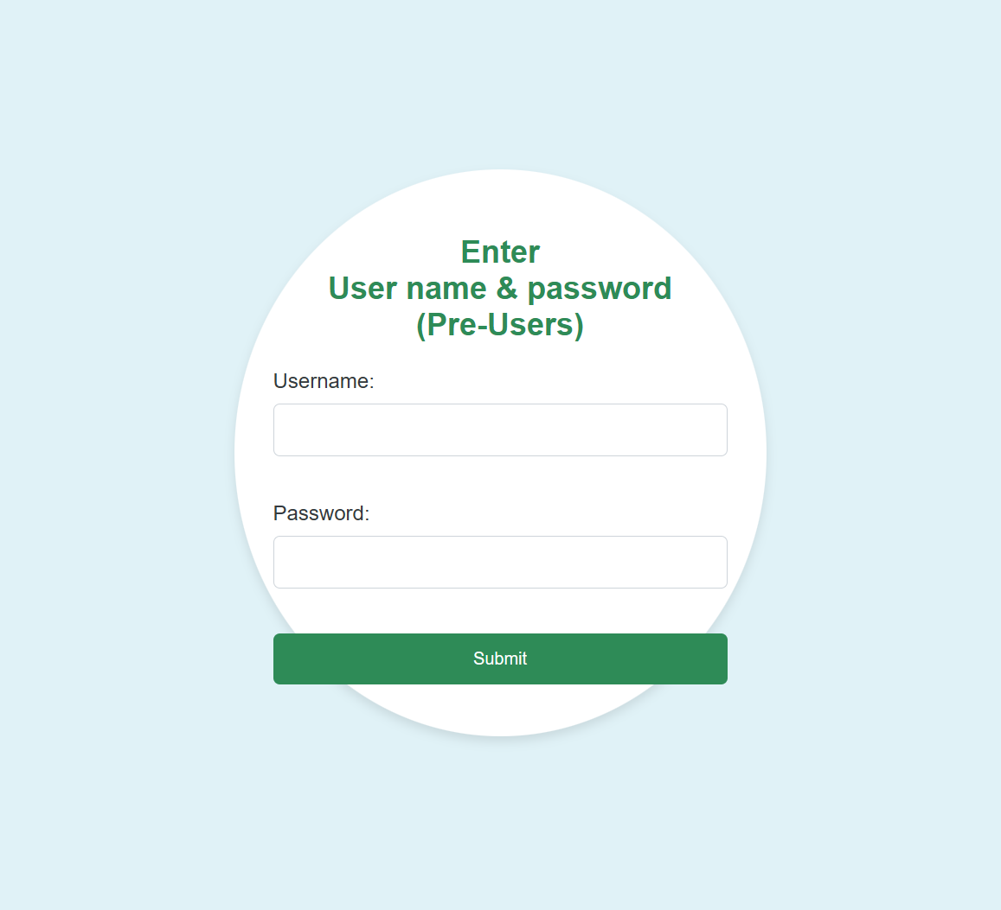
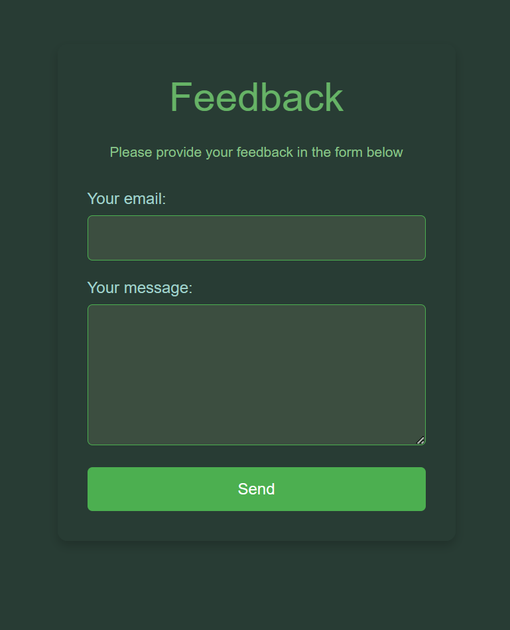
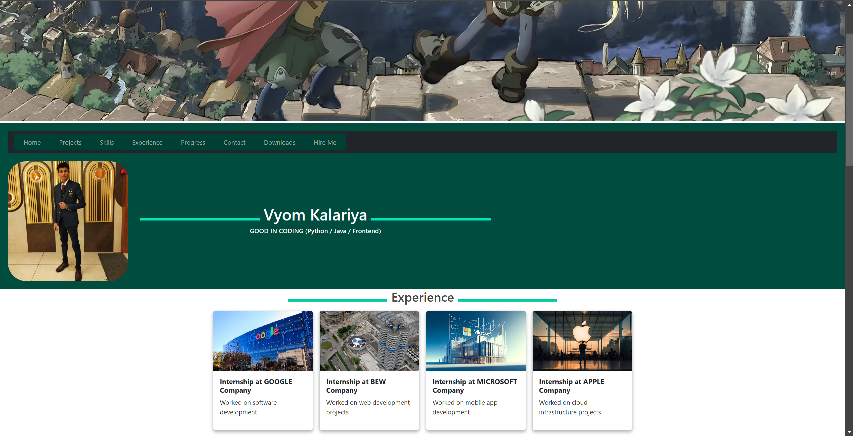
For Developers
Login Form
Feedback Form
DBMS for Understanding User

Slide 7
☺ Thank You Very Much For Understanding My Code ☺

